Slide 1
Data Mesh
Applied DevOps to the world of Data Analytics
Anurag Kale
Cloud and Data Architect | AWS Data Hero
Gothenburg, Sweden

Slide 2
Agenda
Data Analytics challenges
DevOps as inspiration
Data Mesh

Slide 3
About me
AWS Data Hero since 2022
~10+ years in the IT industry
Worked in Consultancy, Startups, Product and Enterprises
Worked as Developer, Operations and Architect in Application and Data worlds
Just left Polestar
Starting a new gig next week

Slide 4
Data functions in Enterprises
Brittle, Ops heavy
Application1
Reports
ETL/ELT
Application 2
DWH / Data Lakehouse
Application 3
Dashboards
Application N
Data Engineers, ETL Developers,
BI Developers, Data Analysts, Data Architects etc
Machine Learning
Can’t freely access data
Bottleneck, gatekeepers

Slide 5
Application functions a few years ago
Brittle, Ops heavy
Application1
Build
Application 2
Operations centre
Application 3
Application
Application N
Build engineers, Production Support, Operations, SOC
Can’t freely access logs
Bottleneck, gatekeepers

Slide 6
DevOps Revolution

Slide 7
Cross functional teams
Designer
Digital
Product
Dev
Ops
InfoSec
Product Manager
QA

Slide 8
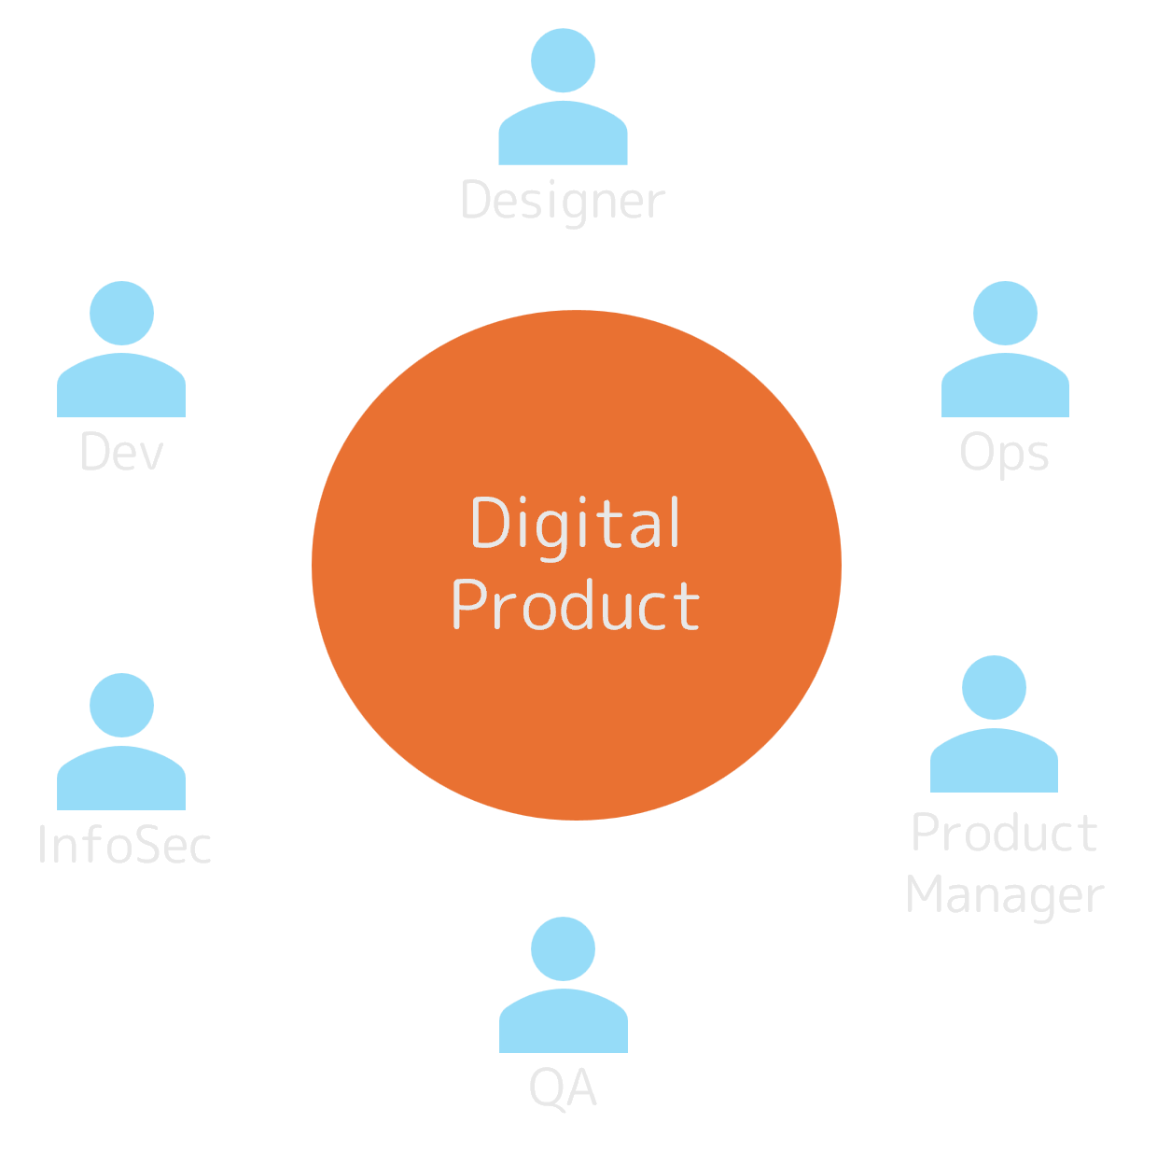
Cross functional teams
Value Stream 1
Why don’t we have any data personas?
Value Stream 2

Slide 9
What if we apply this to Data world?

Slide 10
Application
DWH / Data Lakehouse
Report
Dashboards
Machine Learning
Data + Metadata
Data Product
Enabling Data Platform
Compute | Catalog | Policy | Governance
ETL responsibility of product team
With metadata we can confidently establish the meaning of data
Governed and trusted
Application 2
RAG / Data Science
Data + Metadata
Data Product
Local Feedback Loops

Slide 11
New cross functional team
QA
Designer
Dev
Digital
Product
Ops
Product Manager
InfoSec
Data Engineer
Data Scientist

Slide 12
Domain Driven Design
To find the right granularity of data products

Slide 13
Understanding the subdomains
Core subdomain
Something the company does differently
Source of competitive advantage
Generic subdomain
Something everyone does
Complex but doesn’t provide any competitive advantage
Supporting subdomain
Functions that supports business operations
Low complexity, but does not provide any competitive advantage
Notes:
Shorten or change the way to do more graphically

Slide 14
Decision tree
Buy
Build
Generic
Core
Complexity
Outsource
Generic / Supporting
Supporting
Differentiation

Slide 15
Context Map
Reservation
Payments
U
Conformist
D
customer supplier
Display
Published Language
Payments
generic sub-domain
User Mgmt
Reservation
core sub-domain
Audit
Security
supporting sub-domain

Slide 16
Bringing it all together

Slide 17
Application
Data + Metadata
Data Product
Reports
Application
DWH / Data Lakehouse
Data + Metadata
Data Product
Dashboards
Machine Learning
Application
Data + Metadata
Data Product
Stream aligned Data Products
Business aligned Data Products

Slide 18
Closing thoughts
Data Mesh’ing does not mean we get rid of centralised data teams
It’s a socio-technical approach, requires top-down buy-in
Data Mesh is striving for loose coupling, supports agility
Agile manifesto applied to Data Analytics

Slide 19
Thank you! Questions?
iAnuragKale

